Slide 1
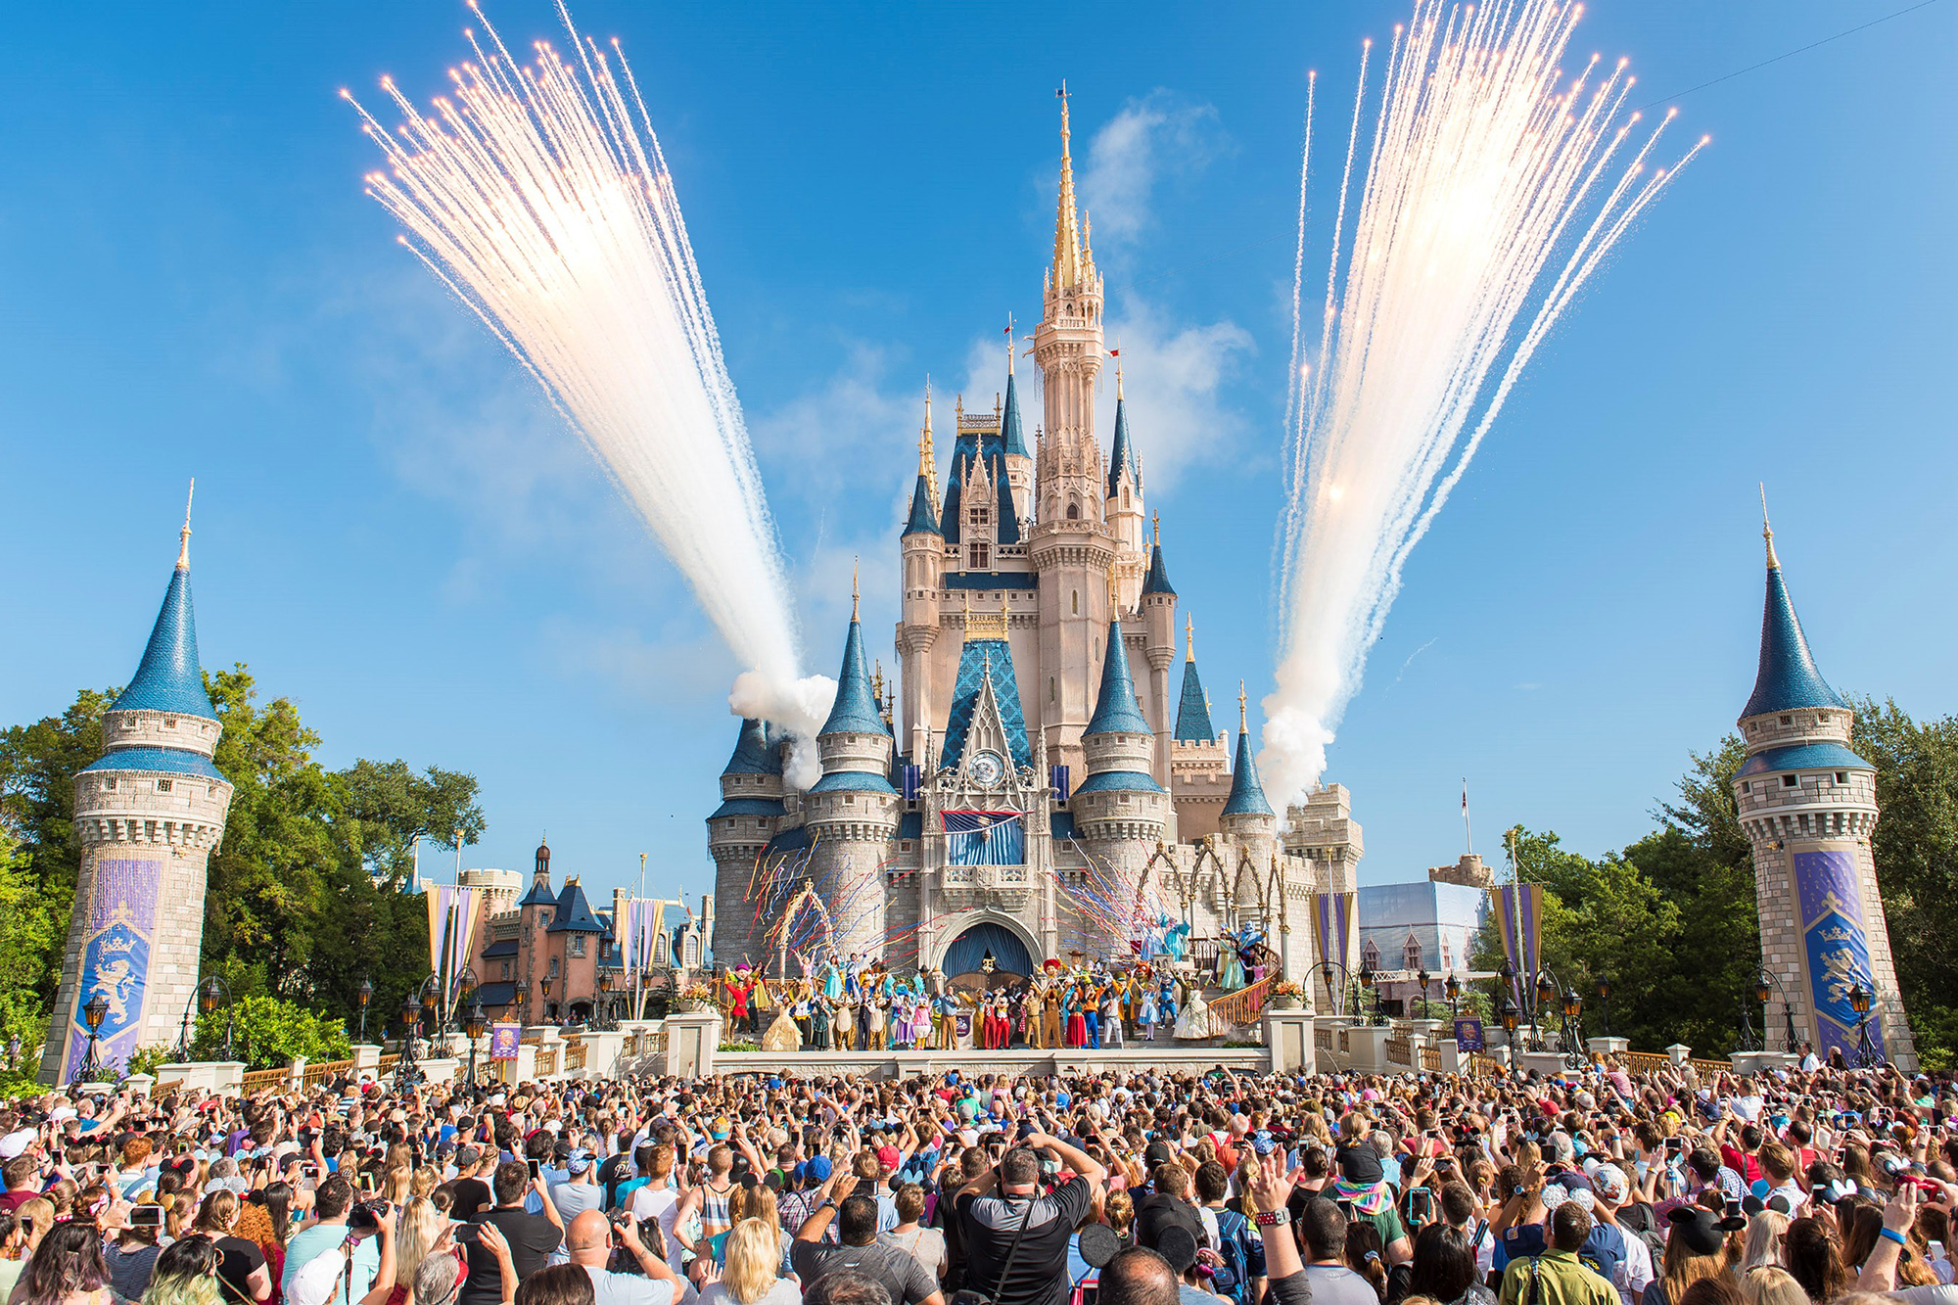


Slide 2


Slide 3

FROM HUMBLE BEGINNINGS
SUB-CONTRACTOR
Concrete
Steel – Metal Building
Carpentry

Slide 4



TRUST
RESPONSIBILITY
INTEGRITY
PASSION

Slide 5
CROSSLAND
INTERNSHIP PROGRAM
Crossland Internship Program started in 1992 with Four Interns
150+ Interns
Paid Hourly Wage ($1,500,000)
Paid Housing
$500,000 in Annual Scholarships
Company Sponsored Events

Slide 6




CROSSLAND ACADEMY
2016 National Exemplar
Crossland Academy began in 2004
Equipment Training & Certification
National Accredited
NCCER Certified Training Programs
DOL Carpenter & Ironworker
Concrete Apprenticeship Programs
Extensive Mentoring Program
Safety Training
Language Training
Minimum of 40 Hrs of Continuing Education Required Annually
NATIONAL
AWARDS
AISC/ACI/PCI

Slide 7


CIVIL SIDE
Heavy Civil & Industrial
Wastewater Treatment Plants
Water Treatment Plants
Pump Stations
Site Development
Municipal Water, Sewer & Storm
Utilities
Municipal Parks & Recreation
Transportation
Oil & Gas
EST. 1994

Slide 8


84 Buildings
6,630,000 Square Feet
$456,795,000 Value
2018 - $50,00,000 Projects 7-8
500,000 Square feet

Slide 9



4 COMPANIES

Slide 10

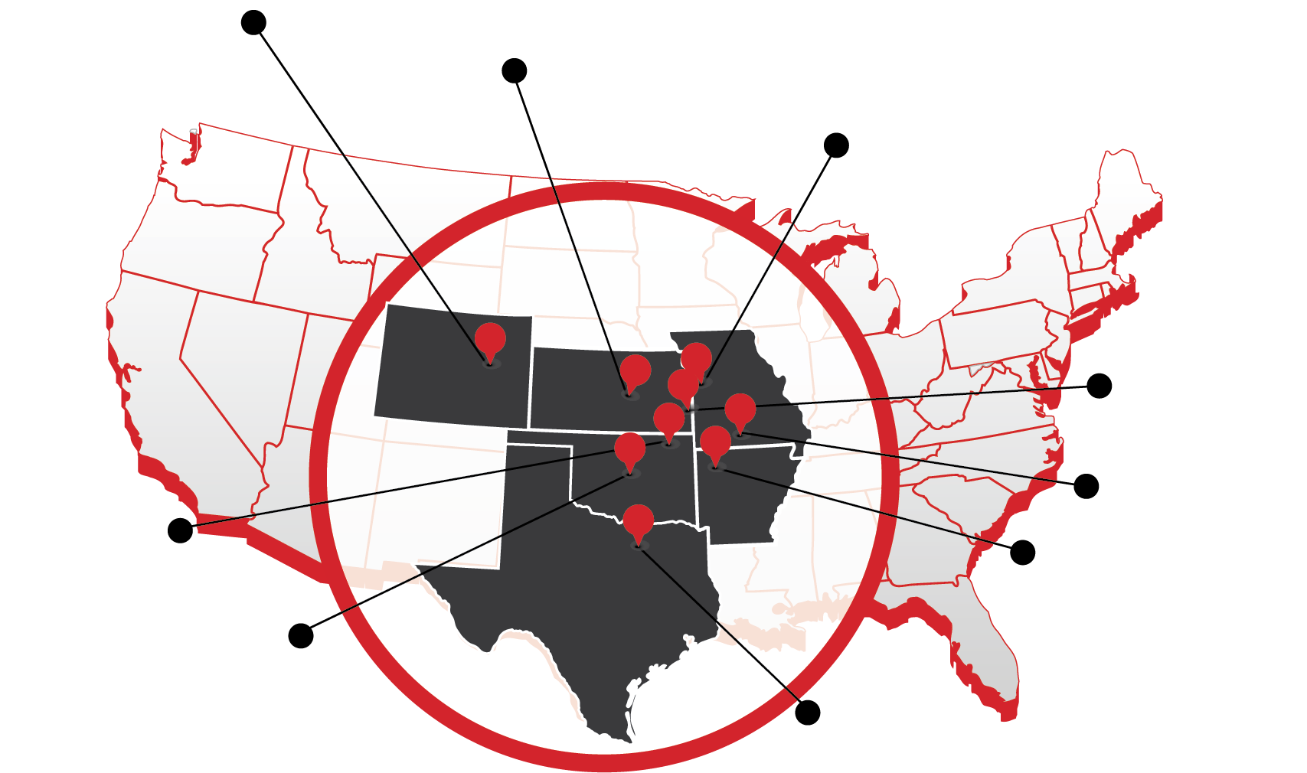
9
OFFICE LOCATIONS
LICENSED IN 38 STATES

Slide 11


NUMBER OF EMPLOYEES

Slide 12
OUR GROWTH
CROSSLAND ANNUAL REVENUES

Slide 13

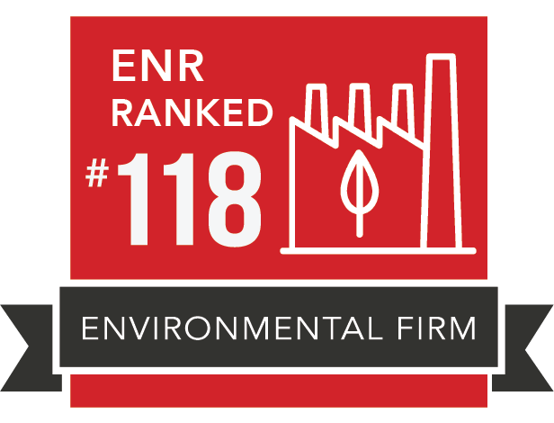
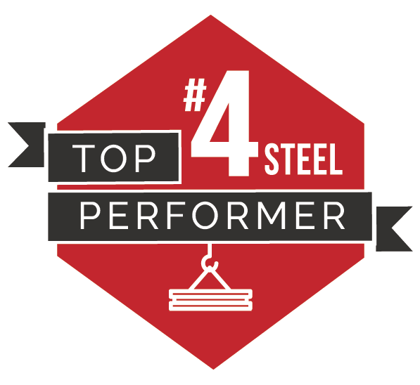


NATIONAL RANKINGS

